Slide 1
PnP Transformation Process
<Consultant Name>
<Job Title>
<Company Name>

Slide 2










Why transition to App Model
IT Pro
Scalable Solution
Align with service roadmap
Agile and faster deployment
You control release process
Cloud Enabled
Developers
Open APIs
Responsive UI
Cross-Device
Social
Security
Notes:
Full trust solutions have implications on Disaster Recovery Model
Full trust solution deployments cause downtime
Full trust solutions have to be closely analysed
Sandbox solutions are deprecated

Slide 3

Why participate in the PnP Transformation program
Modernize your custom SharePoint applications
Take advantage of new features and benefits of the standard App model
Enhance your existing custom solutions by leveraging the power of the App model
Leverage the community IP and expertise
The vNext platform of Office 365 is app model platform
Notes:
Despite the benefits of APP model, you may still need extra help to transition to App model. This might need services of an MS Partner.

Slide 4

vNext principles
FTC not recommended
By default traffic flows through Internet
Capabilities “match” Office 365 MT
Azure has normally a role
Notes:
FTC: Full Trust Code
Office 365 MT: Office 365 Multi Tenant
Align to the cloud service roadmap
Cloud App Model offers new capabilities

Slide 5
Application Modernization PnP Transformation Approach
Customer Preparedness
Solution Assessment
Architecture Session
STEP 1
Empower & Plan
App hosting configuration. Leverage available resources to ramp up Dev resources
Analyze solution inventory / requirements and provide guidance on solution modernization
Provide architecture design guidance for selected scenarios
Deliverable:
Successfully smoke test app to validate configuration
Deliverable:
Assessment report
Deliverable:
Architecture Design Report
Development SOW (optional)
Development & Testing
Deployment
STEP 2
Develop & Deploy
Jointly work on development and testing with MS partners
Retract FTC
Deploy App solutions
Deliverable:
Tested solution artifacts
Deployment Guide
Deliverable:
Replace FTC by APP
Project signoff
Notes:
FTC: Full Trust Code
SOW: Statement of Work

Slide 6
Planning Calendar
Everybody
Customer Preparedness Workshop 1
Customer Preparedness Workshop 2
Solution assessment functionality demo 1
Solution assessment functionality demo 2
Solution assessment outcome discussion
Solution report outcome discussion
Next Steps
Customer demonstrates the customizations
Focus on App Hosting
Focus on App Development
Share Findings
Propose design
Activity
IT Admin
Developers
Audience
Notes:
Audience might vary based on how the organisation is structured

Slide 7

Questions?

Slide 8

aka.ms/OfficeDevPnP
Transform your code
Providing App Model Patterns for common scenarios Open source and based on community contributions Constantly evolving set of material for reuse
100+ Visual Studio projects
Common scenarios Branding Site provisioning Remote event receivers
UX component Taxonomy driven navigation And much more…
Patterns and Practices Yammer Group - http://aka.ms/officedevpnpYammer

Slide 9
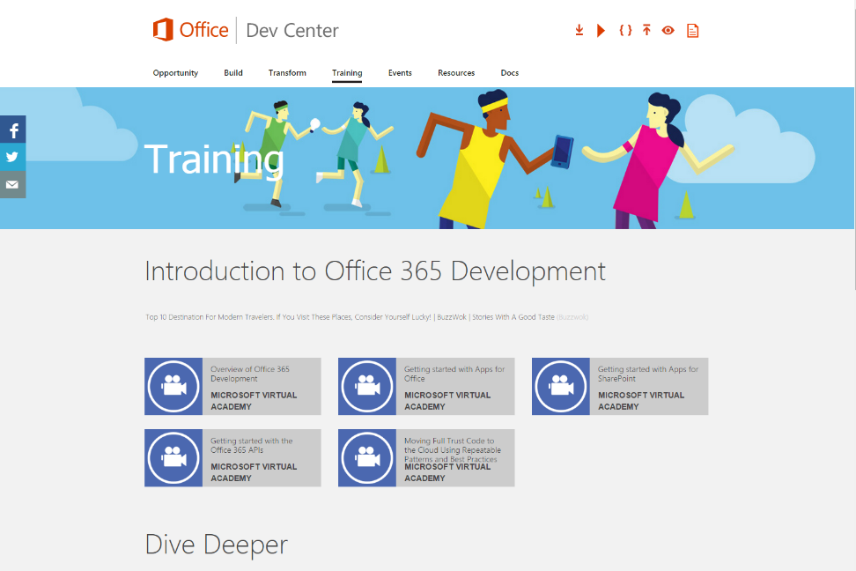
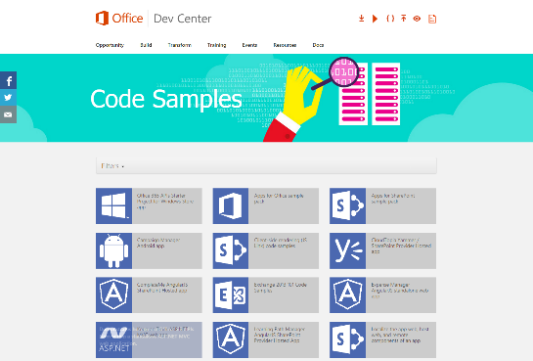
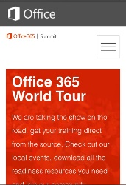
dev.office.com
Sign up
http://dev.office.com/getting-started
Explore
http://apisandbox.msdn.microsoft.com
Get trained http://dev.office.com/training

Slide 10


Feedback
Office 365 Network Share you best practices and join conversations
https://www.yammer.com/itpronetwork
Stackoverflow Ask deep technical questions to a world-wide set of developers
http://stackoverflow.com/questions/tagged/ms-office
User Voice Provide suggestions of what you want in future versions
http://officespdev.uservoice.com/

Slide 11


© 2015 Microsoft Corporation. All rights reserved. Microsoft, Windows, and other product names are or may be registered trademarks and/or trademarks in the U.S. and/or other countries.
The information herein is for informational purposes only and represents the current view of Microsoft Corporation as of the date of this presentation. Because Microsoft must respond to changing market conditions, it should not be interpreted to be a commitment on the part of Microsoft, and Microsoft cannot guarantee the accuracy of any information provided after the date of this presentation. MICROSOFT MAKES NO WARRANTIES, EXPRESS, IMPLIED OR STATUTORY, AS TO THE INFORMATION IN THIS PRESENTATION.

